Slide 1
Project 4: OCR post-processing
Group 8:
Bai, Ruoxi rb3313
Loewenstein, Oded orl2108
Yan, Jiaming jy2882
Zhong, Qingyang qz2317
Zhu, Siyu sz2716

Slide 2

Work Flow
Data Preprocessing
Error Detection [D1]
Error Correction [C2]
Evaluation

Slide 3
1.
Data Preprocessing

Slide 4
Data preprocessing
1. Find pairs of Tesseract and ground truth files do not have the same number of lines.
Then trimmed the ground truth files manually until they have the same length with the corresponding Tesseract files.
There are 13 pairs.
2. Delete rows in ground truth and tesseract which character number don’t match.
About 11.32% of the data are deleted.
ground_truth_trimmed

Slide 5
2.
Error Detection

Slide 6
Rule based error detection
D1 Sectiom2.2
If a string composed of more than 20 symbols
If the number of punctuation characters in a string is greater than the number of alphanumeric characters
Ignoring the first and last characters in a string, if there are two or more different punctuation characters in the string
If there are three or more identical characters in a row in a string
If the number of uppercase characters in a string is greater than the number of lowercase characters, and if the number of uppercase characters is less than the total number of characters in the string
If there are four or more consecutive vowels in the string or five or more consecutive consonants in the string
If all the characters in a string are alphabetic, and if the number of consonants in the string is greater than 8 times the number of vowels in the string, or vice-versa
If the first and last characters in a string are both lowercase and any other character is uppercase

Slide 7
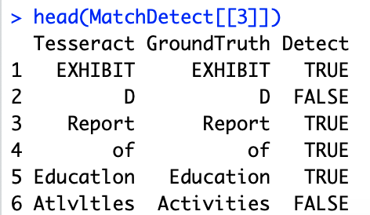
Output
Wrongly identify a correct word as error.
Violation of Rule:
If all the characters in a string are alphabetic, and if the number of consonants in the string is greater than 8 times the number of vowels in the string, or vice-versa
Fail to identify a true error.
Confusion Matrix

Slide 8
3.
Error Correction

Slide 9
Features
Regression
Tune Parameters
Candidate Search

Slide 10
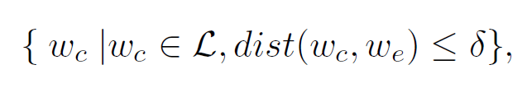
Candidate Search
Place your screenshot here
1. The candidates are chosen from dictionary created from ground truth.
2. Then we calculate the Levenshtein distance for each candidates and choose top 3 for the following step.
Levenshtein distance

Slide 11
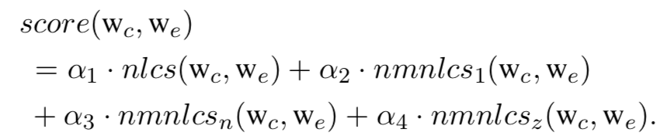
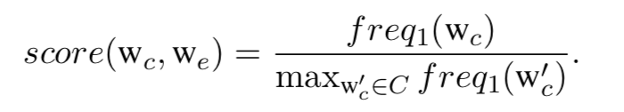
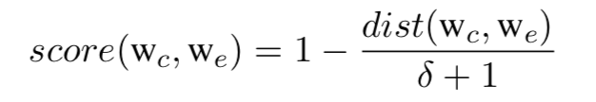
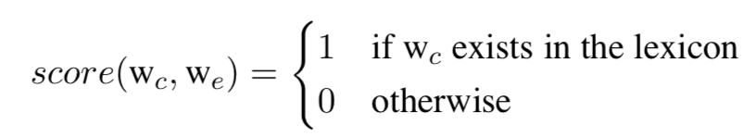
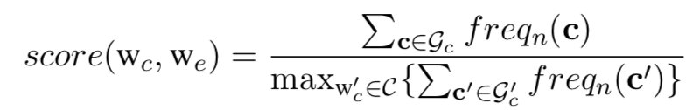
Features
1.Levenshtein edit distance
2.String similarity
3.Language popularity
4.Lexicon existance
5.Exact-context popularity
6.Relaxed-context popularity

Slide 12
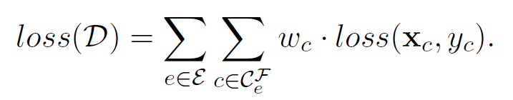
Regression
Place your screenshot here
AdaBoost.R2 model on top of decision trees with 0-1 loss function.
Label candidate with 1 if it equals to ground truth, else 0.

Slide 13
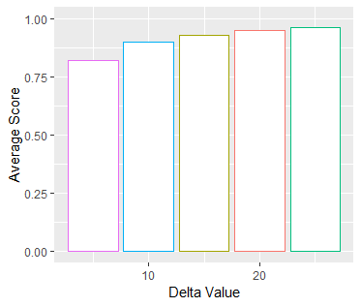
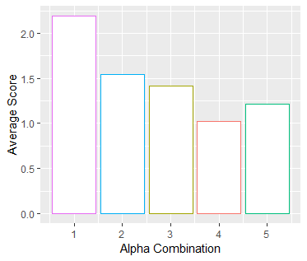
Tune Parameter
Alpha1=0.5, Alpha2=0.25, Alpha4=0.25
25
Delta in Levenshtein edit distance
Combination of alpha in String similarity

Slide 14
4.
Evaluation

Slide 15
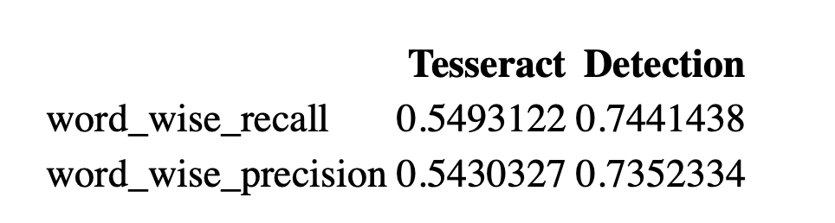
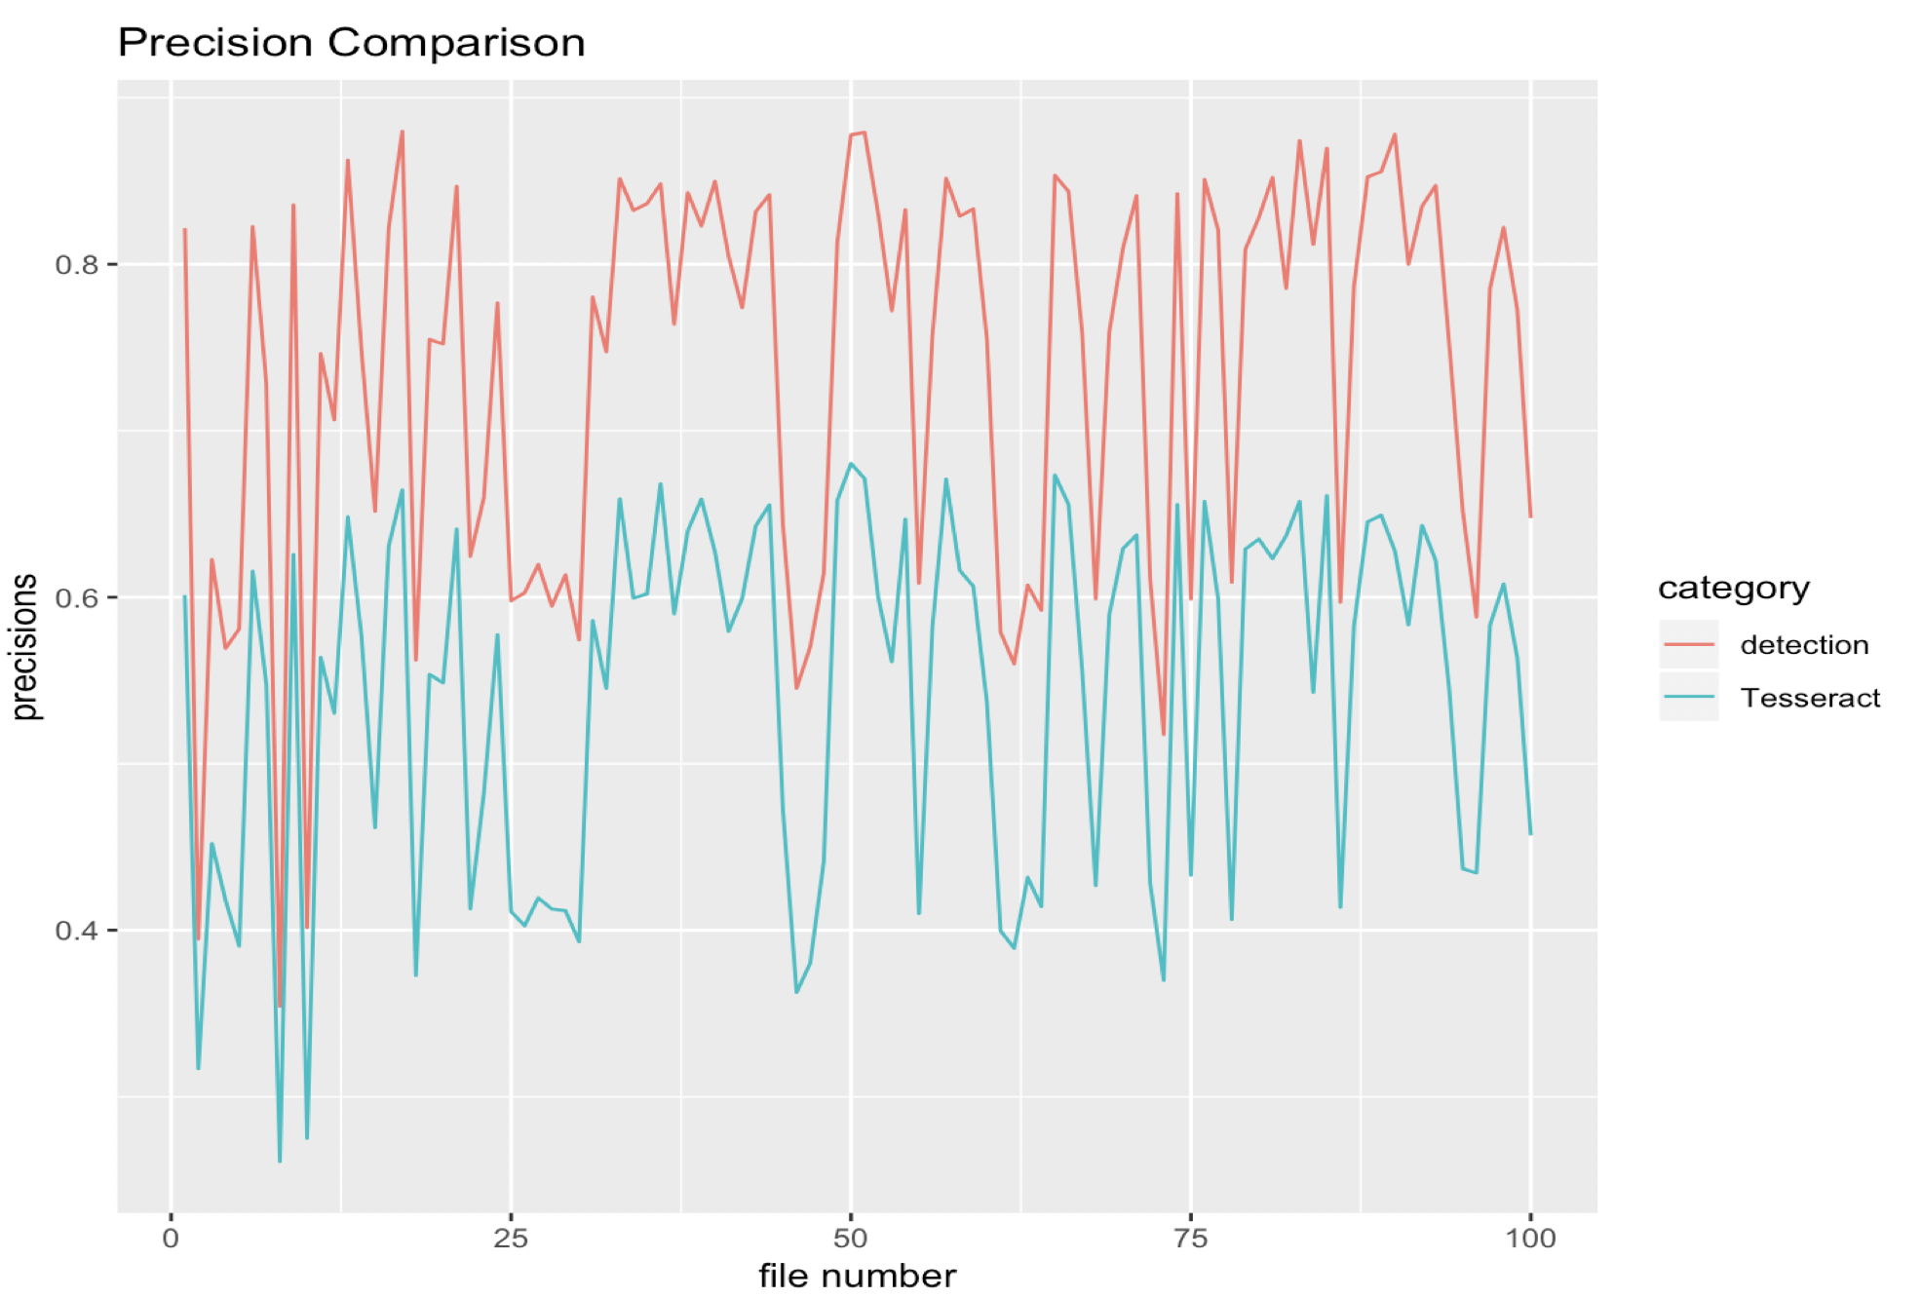
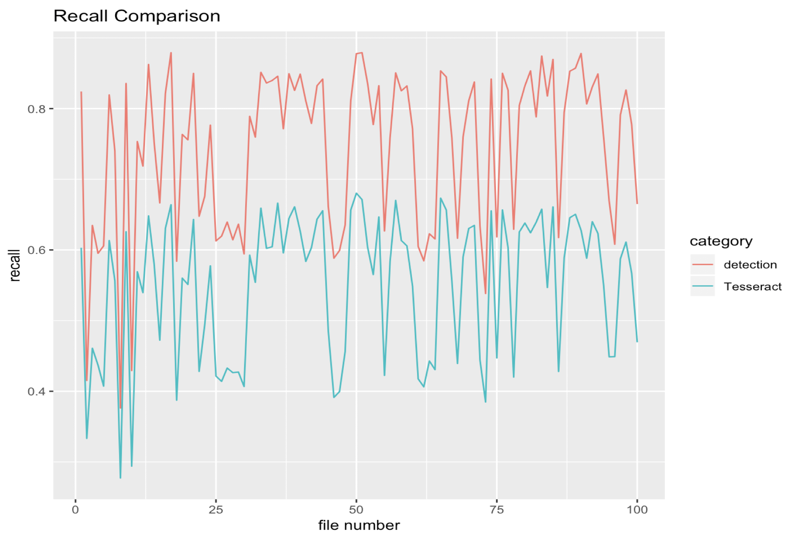
Detection Evaluation
Word Wise Recall and Precision

Slide 16
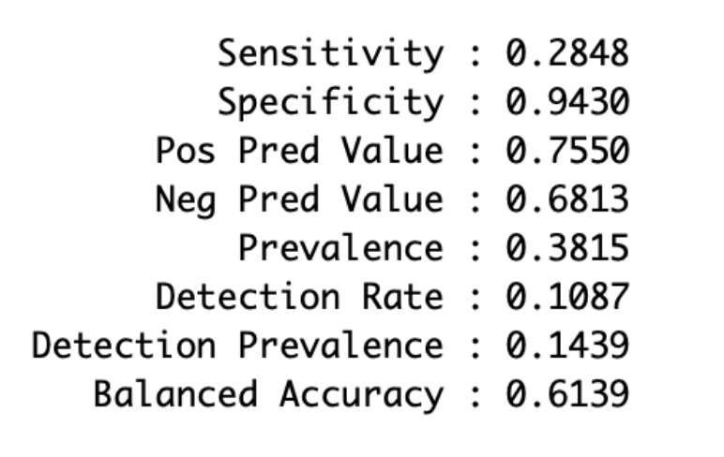
Detection Evaluation
Place your screenshot here
Confusion Matrix
Reference[GroundTruth]
 | False | True
False | 28180 | 9145
True | 70768 | 151262
Prediction [Detection]

Slide 17
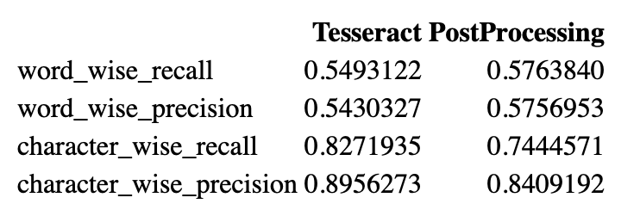
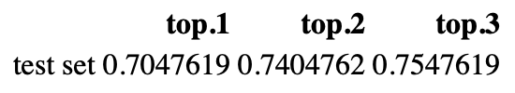
Correction Evaluation
Word & Character Wise Recall and Precision
Top 3 Candidate Coverage

Slide 18
Evaluation
Disadvantages:
1. Detection method is rather intuitive and not context adjusted
2. Cannot correct “separated word case”
example: ‘spend’ → ‘sp’ ‘end’
3. The feature calculation part is more demanding on computational resource

Slide 19
Thanks!
Any Questions?

